Slide 1
Advance Electronic I
THIRD YEAR
Lecturer: Abbas S.
Hameed
Main References:
1- Robert L. Boylestad and Louis Nashelsky, “ Circuit Theory “.
Electronic
Devices and
2- Thomas L. Floyd, “ Electronic
Devices. CCV “.
3- Adel S. Sedra and Kenneth Carless Smith, “ Microelectronic circuits “.

Slide 2
Review
Lecture

Slide 3
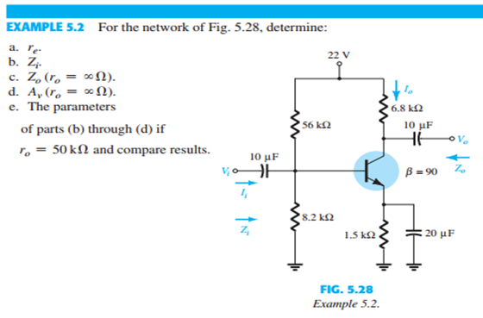
Electronic Devices and Circuit Theory 11th Ed., Robert L. Boylestad

Slide 4
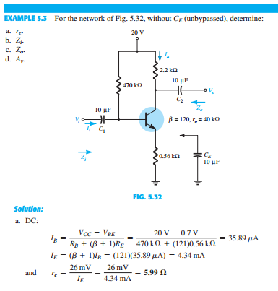
Electronic Devices and Circuit Theory 11th Ed., Robert L. Boylestad

Slide 5
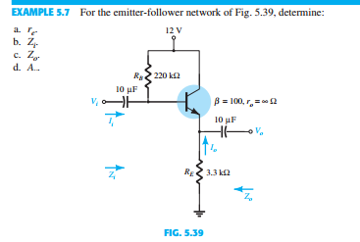
Electronic Devices and Circuit Theory 11th Ed., Robert L. Boylestad

